Slide 1
Welcome to GIS Day at Webb Associates
Notes:
it’s International GIS Day AND Geography Awareness Week

Slide 2
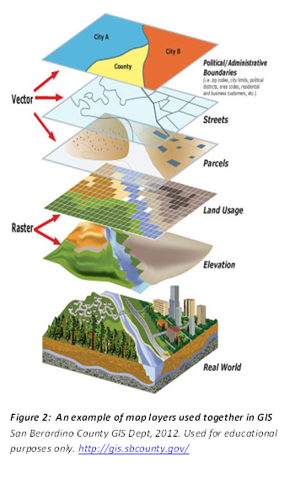
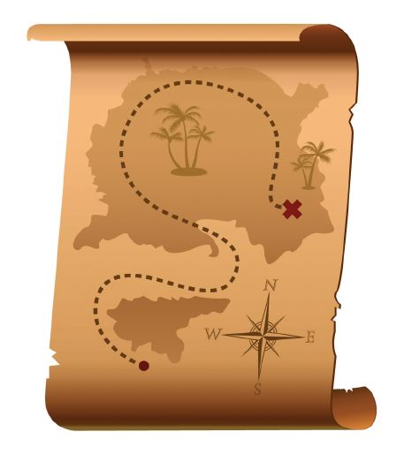
What is GIS?
Visualization - GIS is a tool to display spatial data as a map
Database management - GIS can store and organize spatial data
Spatial Analysis - GIS can analyze and interpret spatial data
Viewshed analysis
Spatial auto-correlation
Map algebra

Slide 3
What is GIS?
A Geographic Information System (GIS) links locational and attribute information and enables a person to visualize patterns, relationships, and trends.
A new perspective of data analysis that cannot be easily seen in a table format or on a paper map.
Estimates are that 80% of all data has a spatial component
It includes things like drones, GPS, Google Earth, and CAD, AND you can ask complex questions and do analyses
“It’s like looking up sexual predators on Criminal Minds but not as fast”

Slide 4
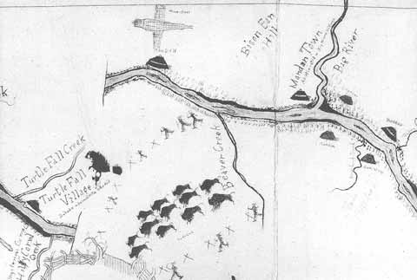
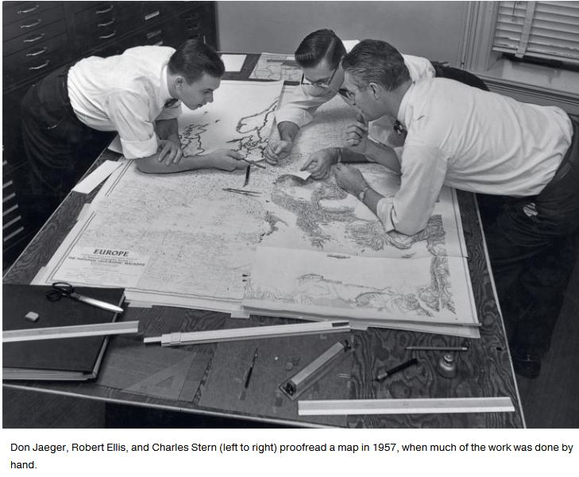
Automated Cartography
Automated cartography
revolutionized map-making,
but GIS is much more than that
and has come so much farther

Slide 5
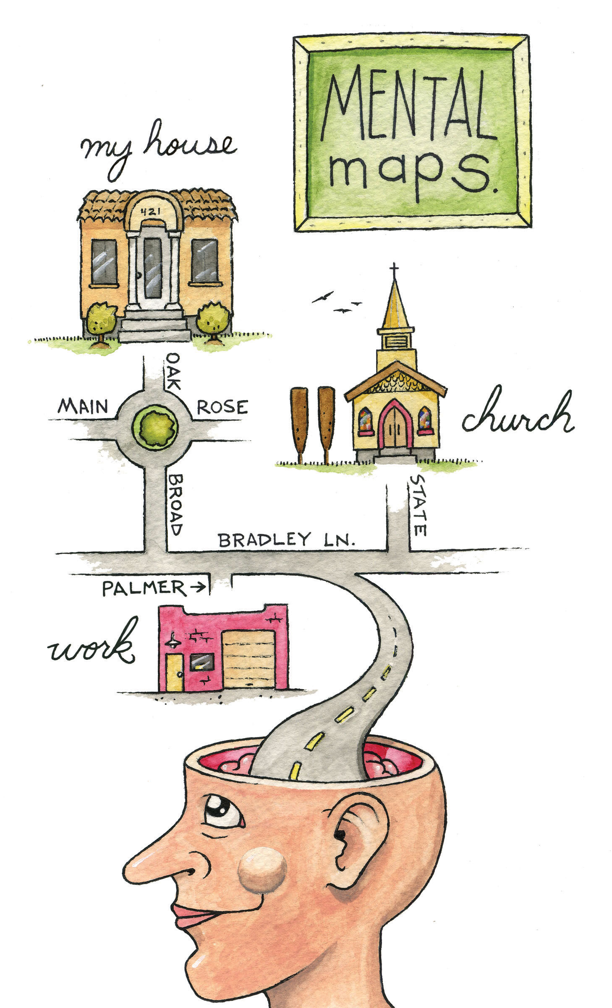
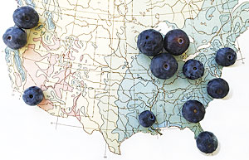
Geography and GIS
Knowing where something happens helps us understand why (and when and how) it happens. Our spatial awareness helps us understand the world around us

Slide 6
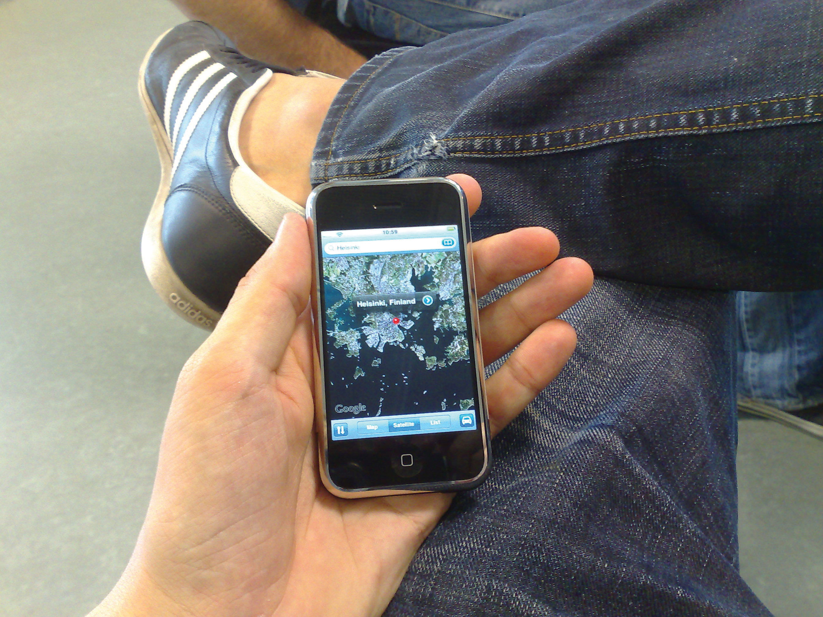
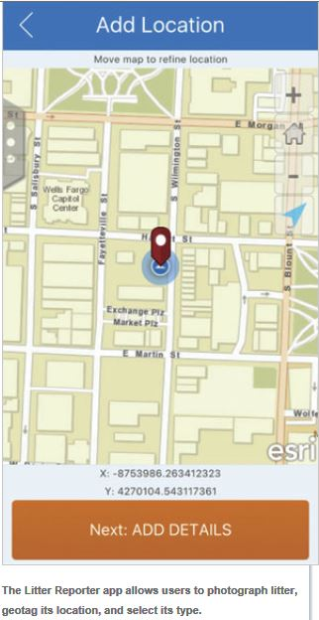
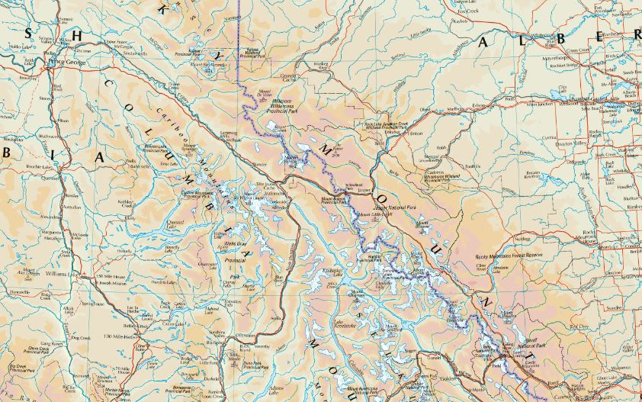
Maps are everywhere, GIS is more integrated with other systems than ever before They are Colorful, they are Interactive, they are Shared
Notes:
No longer folded up accordion-style in your glove box!
From daily tasks like getting directions to a restaurant in SF on your phone to challenges of the future like exploring the consequences of global warming on the treasures of Venice …..

Slide 7
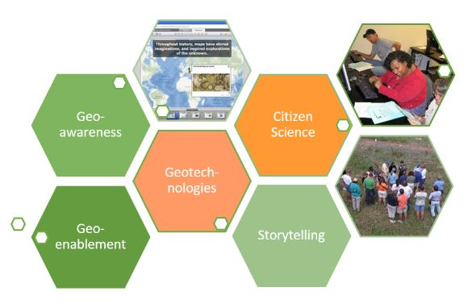
Geography and Our World
Geo-awareness
Geo-enablement
Geotechnologies
Citizen Science
Storytelling
Geoliteracy

Slide 8
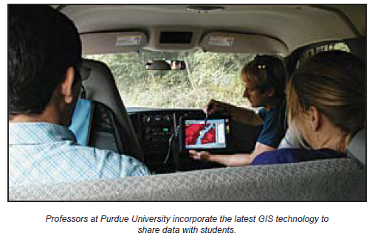
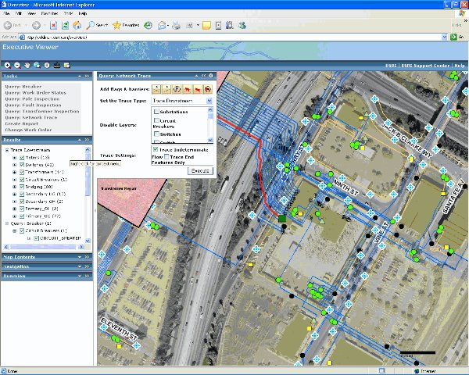
How is GIS Used?
Government
Local, State, Federal, Military
Emergency Services
Fire and Police
Environmental
Monitoring and Modeling
Education
Research, Teaching, Administration
Business and Industry
Site Location, Market Demographics, Routing
Infrastructure and Public Services
Transportation, Communication, Mining, Pipelines, Healthcare

Slide 9
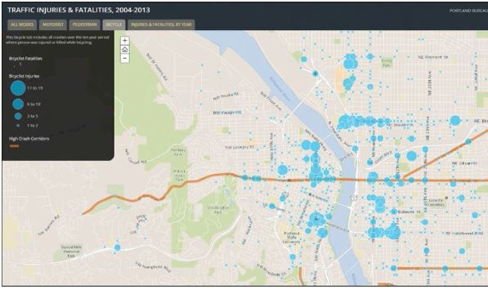
Almost everywhere!
City of Riverside Story Map

Slide 10
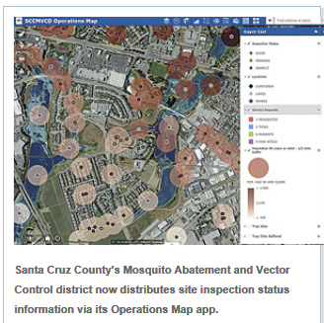
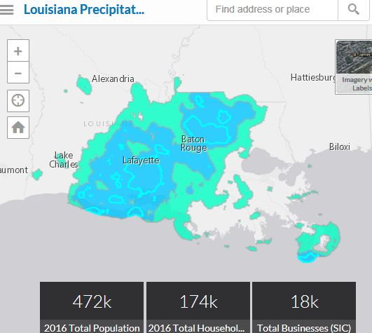
Public Safety and Emergency Response
The Malaysia Airlines flight that disappeared over Ukraine in July 2014 happened on the last day of the UC – Esri’s DRP immediately mobilized, in a hotel conferenece room. The DRP uses GIS to create crowdsourcing apps, storm surge maps and evacuations plans.
The status data for every mosquito-breeding site in Santa Clara County is now available to all users on their desktops and their mobile devices. The Operations Map app also contains tools that allow users to edit data and conduct spatial analysis, They can also measure the area of a site during an inspection so a precise amount of mosquitocide can be applied.
Notes:
Public Safety: crime heat maps, patrol car location, route optimization, also disaster mapping and recovery

Slide 11
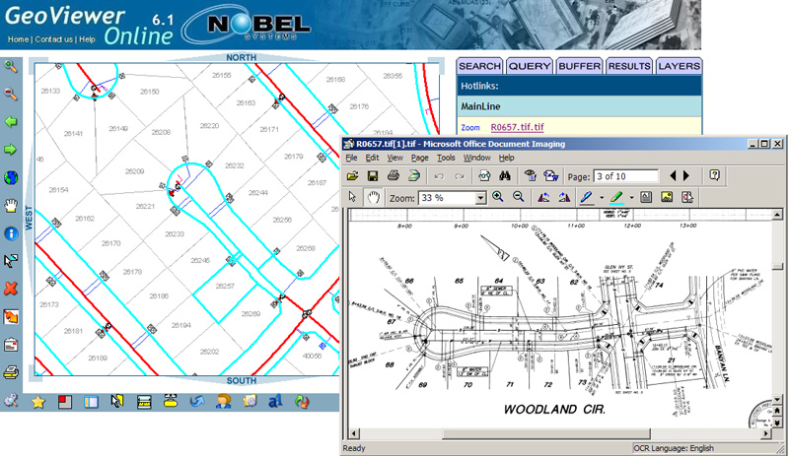
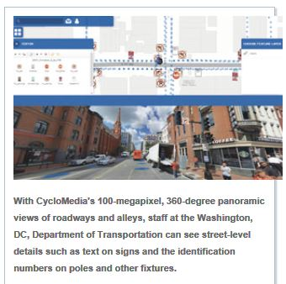
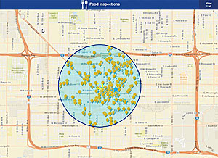
Utility Management and Public Services
Maricopa Co. Restaurant Ratings App
Business System Integration
DC Parking App
CIP Story Map
Notes:
Utilities: Can be linked to customer database, work orders (business system integration

Slide 12
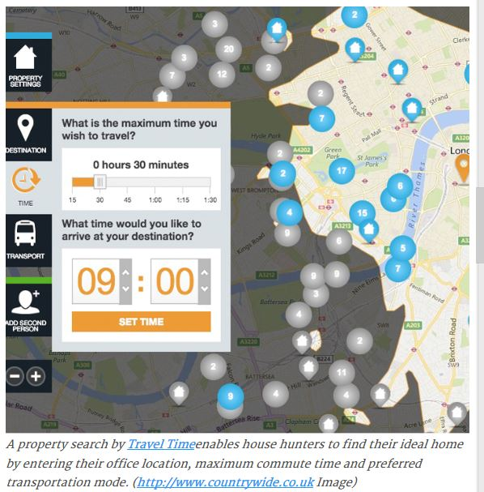
Real Estate and
Economic Development
Moreno Valley Retail Map
Riverside ED Story Map
Notes:
Agriculture: Model soil and environmental variables to put the right crop in the best area; using GPS to level fields for irrigation; statistics
Planning: SJ Levee – conveying spatial relationships; constraints analyses
Also Marketing is a big area – analyzing customer preferences and locations, siting a new business, etc.

Slide 13
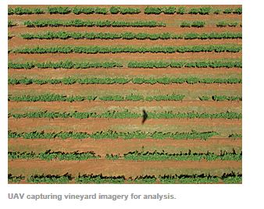
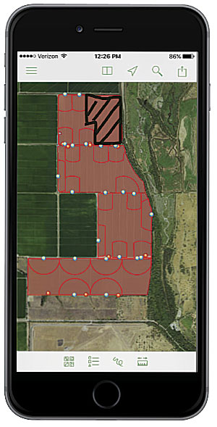
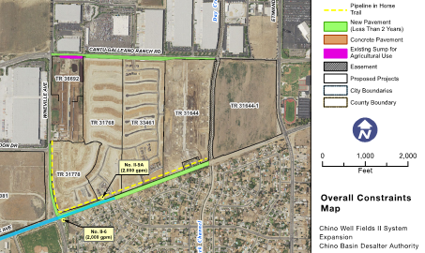
Agriculture Planning Survey Environmental
TNC BirdReturns – “popup” wetland habitat! – GIS predicts water bird occurrence based on surface water availability, etc., then farmers are invited to participate in a “reverse auction” – bid for providing habitat access in 2-week increments in Fall and Spring, bids are evaluated in relation to occurrence model scores, other protected areas, etc., field crews sample use and compliance with Explorer
Riverside Survey Dept. Uses GIS
Notes:
Agriculture: Model soil and environmental variables to put the right crop in the best area; using GPS to level fields for irrigation; statistics
Planning: SJ Levee – conveying spatial relationships; constraints analyses
Also Marketing is a big area – analyzing customer preferences and locations, siting a new business, etc.

Slide 14
Education
Notes:
Agriculture: Model soil and environmental variables to put the right crop in the best area; using GPS to level fields for irrigation; statistics
Planning: SJ Levee – conveying spatial relationships; constraints analyses
Also Marketing is a big area – analyzing customer preferences and locations, siting a new business, etc.

Slide 15
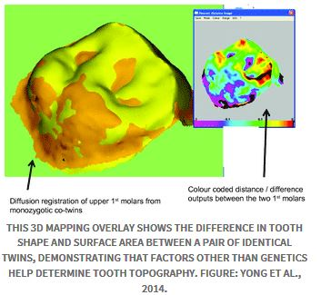
Etc., Etc.
Dentistry! – mapping “malignant anomalies”; spatio-temporal mapping (change detection); 3D mapping; regional public health analyses
The 2020 Census is now relying more on imagery and GIS to do canvassing and address verification (saving almost $1 billion) and is using more mobile GIS technology (navigation, workload management) in the field for even greater projected savings
ALI Story Map

Slide 16
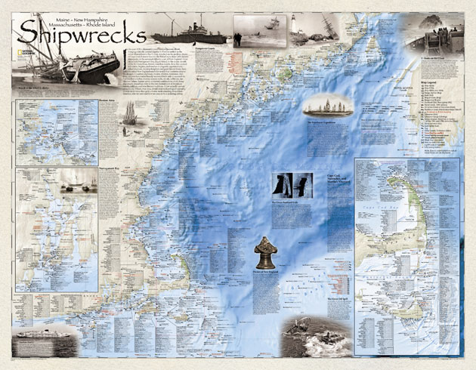
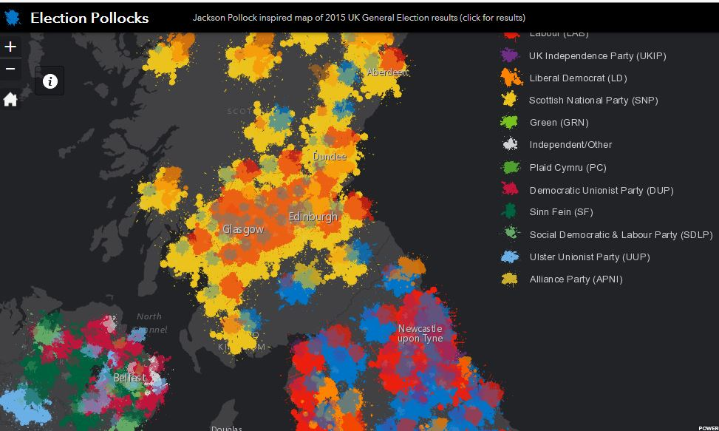
Cartography and Storytelling
Cumbres and Toltec Story Map
Notes:
This is what draws us to GIS and map-making – there is nothing like losing yourself in the story of a good map. How a map is put together – the colors, the layers, the emphasis is very important to get your message across clearly and effectively.

Slide 17
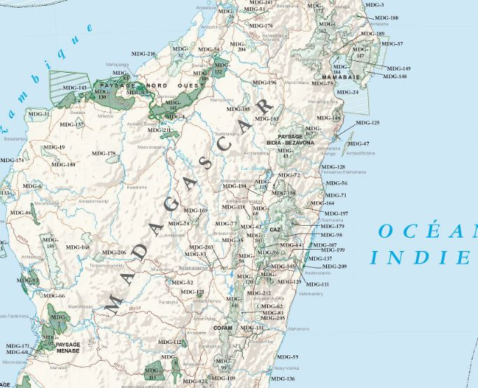
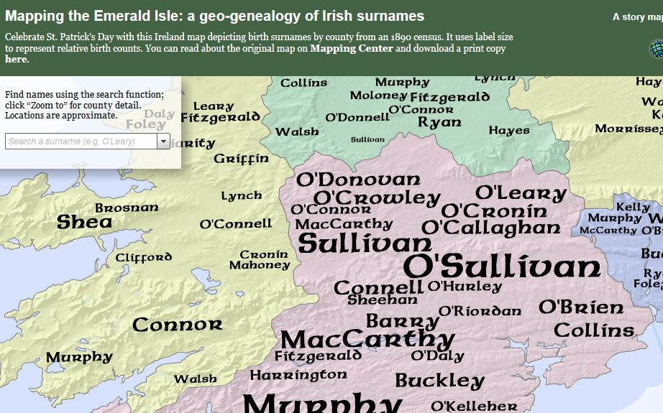
Kentucky Opiods
Zika Virus Map

Slide 18
The Future of GIS
Crowdsourcing - participatory map products
Open GIS – more agencies releasing their data
Authoritative data - quality data from known sources, good documentation
3D and “4D”
Big Data / Location Analytics / Real Time GIS – the Internet of Things, social media feeds
Notes:
Crowdsourcing – great potential, especially during disasters, gets people excited
We like to believe anything on a Map, but they are only as good as the data that makes them!

Slide 19
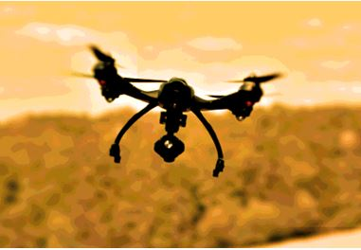
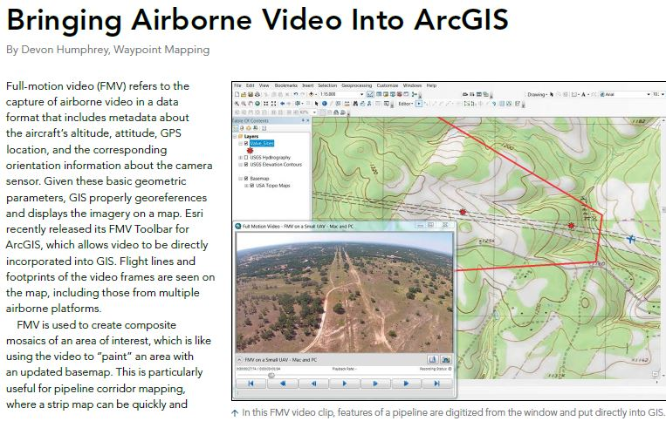
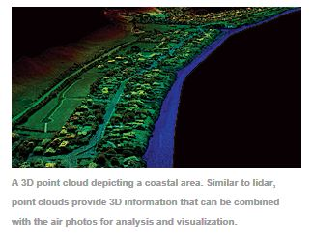
The Future of GIS
Drones/UAV’s/UAS’s
2D and 3D imagery products, habitat analysis, infrastructure and project inspections, change detection and monitoring

Slide 20
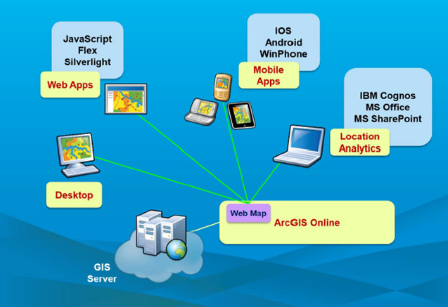
The Future of GIS and ESRI
Dangermond’s 2016 catch-phrase: “Smart GIS Enabling a Smarter World”.
“Geography, mapping and GIS have never been more important. They provide the language of understanding of our world and a platform for creating a better future”
Cloud computing, SoS and online mapping
Systems integration
Notes:
Cloud and online – cost-effective and flexible, facilitates data management and access; GIS products, applications that can run on any device (“pervasive access”)

Slide 21
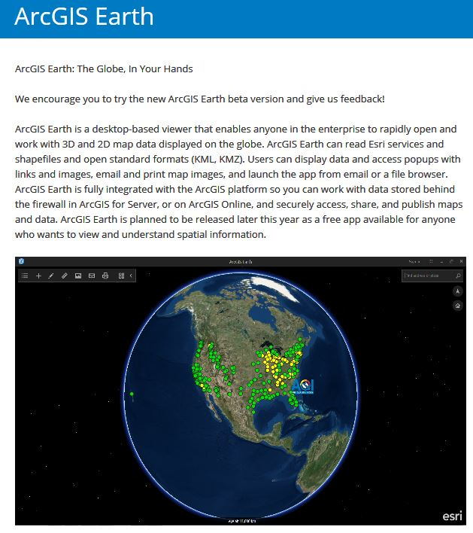
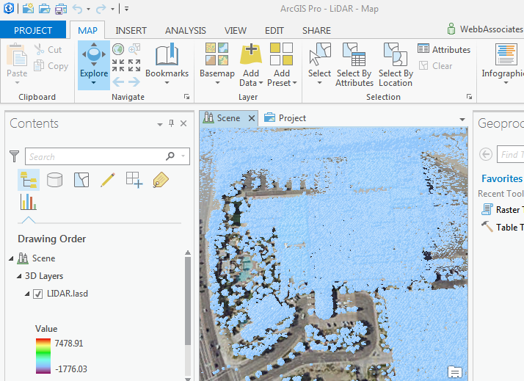
The Future of GIS and ESRI
Story Maps
ArcGIS Pro and ArcGIS Earth
A “Symphony” of Apps!
Notes:
Not just “live posters”. Will be come important part of research, magazines, social media

Slide 22
Questions?

